Slide 1

Introduction to Robotics
2016 Fall

Slide 2
Project Roadmap
Date | Project | Finished?
9/06/16 | Introduction of Robot and Robotics, mBot Assembly | yes
9/13/16 | Introduction of mBlock | yes
9/20/16 | Play an Octave | yes
9/27/16 | Push a Button | yes
10/04/16 | Light Sensor, UltraSonic Sensor | yes
10/11/16 | Drive with Remote, Line Following | yes
10/18/16 | Robot Movement 1
10/25/16 | Robot Movement 2, Trace a Shape
11/01/16 | Obstacle Avoidance
11/08/16 | Sumo Wrestling 1
11/15/16 | Sumo Wrestling 1
11/22/16 | Maze 1
11/29/16 | Maze 2
12/06/16 | C Programming 1
12/13/16 | C Programming 2

Slide 3
Obstacle Avoidance
Program Description
The program will enable the mBot to move forward and avoid any obstacles it encounters.
Requirements
1. The mBot shall execute an avoidance strategy whenever it encounters an object within 5 centimeters.
2. The avoidance strategy shall allow the mBot to navigate around the object and then continue forward movement on the same line it was on before moving around the object.

Slide 4
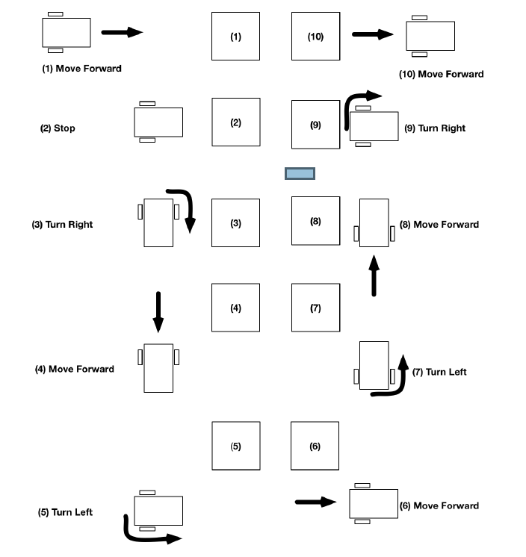
Obstacle Avoidance

Slide 5
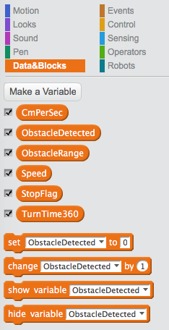
Implementation: define variables
Centimeters per second at the speed used. From the last class
Flag indicating if an obstacle has been detected
Distance to the obstacle in front
Speed to be used
If the robot should be stopped
How many seconds are required for the robot to make a full turn

Slide 6
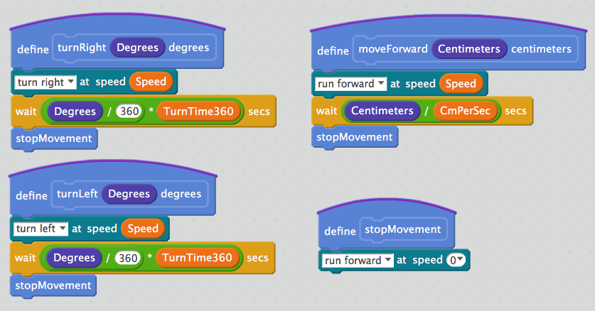
Blocks: moveForward, turnLeft, turnRight, stopMovement

Slide 7
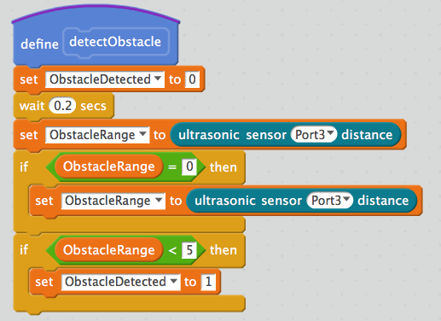
Block: detectObstacle
Read the distance again to ensure there is a value
Detected if the distance is less than 5 centimeters

Slide 8
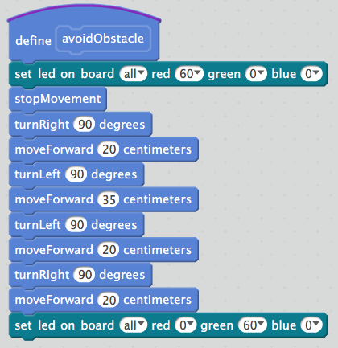
Block: avoidObstacle
Red light: something blocking
Green light: good now

Slide 9
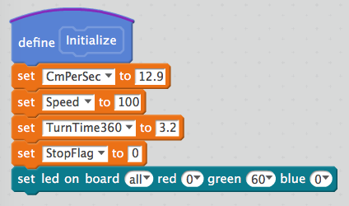
Block: Initialize
All numbers are from the last class

Slide 10
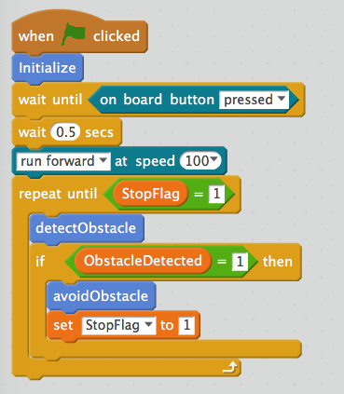
Main Program Logic

Slide 11
Challenges
The strategy used to avoid an obstacle is hard-coded for a specific set of movements and dimensions.
A more flexible approach would be to move forward for a specified distance, and continue to turn in the direction of the obstacle (left if you turned right to avoid it), and check to see if it is still in the way. Now is a good time to consider other more flexible ways of detecting and navigating around the obstacle.
1. Modify the program so that the mBot can move around obstacles of unknown dimensions.
2. Modify the program so the mBot can deal with multiple obstacles of unknown dimensions.

